Slide 1
Async React
www.devbridge.com
Sourcery Academy

Slide 2
Agenda
React Router & Redux
Async JS solutions
Callback practice
Promise practice
Redux Thunk
Todo App Update

Slide 3
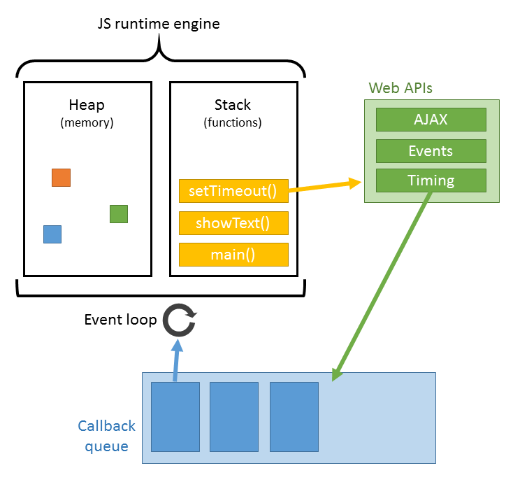
Asynchronous JS
JS in the browser is actually synchronous
It can parallelize work by giving tasks to the browser WebAPI
When done, WebAPI provides results via event loop

Slide 4
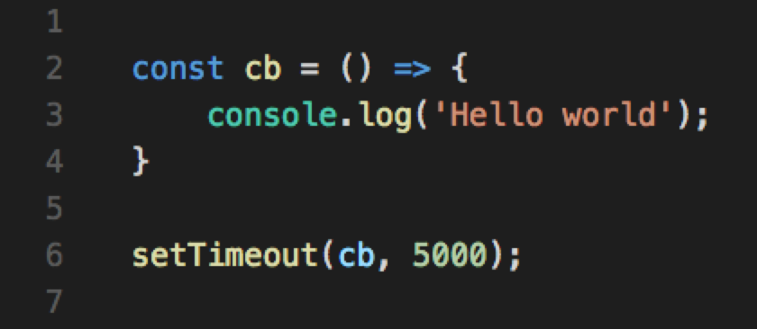
Callbacks
A function, passed as a parameter, that is called on a particular time, when some kind of action happens
Due to asynchronicity we cannot expect things to happen in linear order
Passing a callback is a way to deal with it

Slide 5
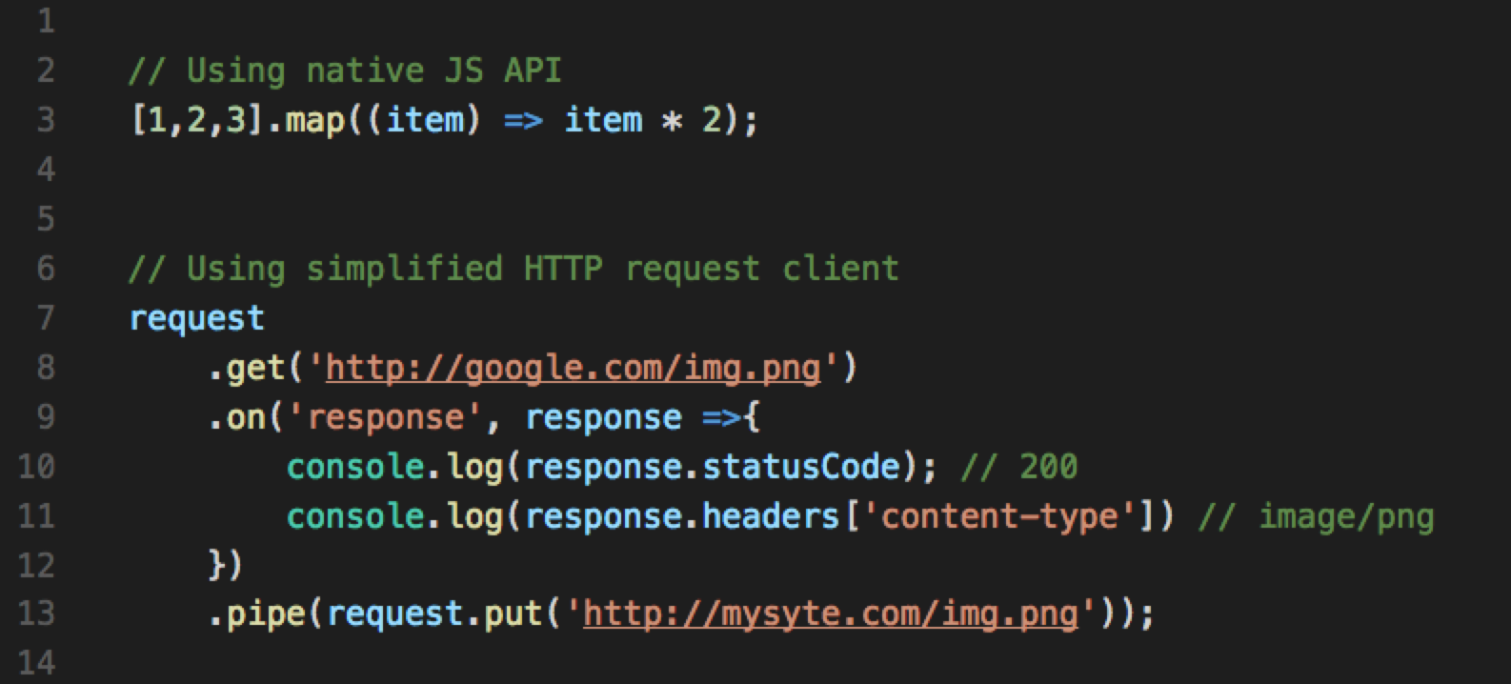
Callback examples
Notes:
Under the hood the mechanism we are calling is handling the request and then just calling our callback with results

Slide 6
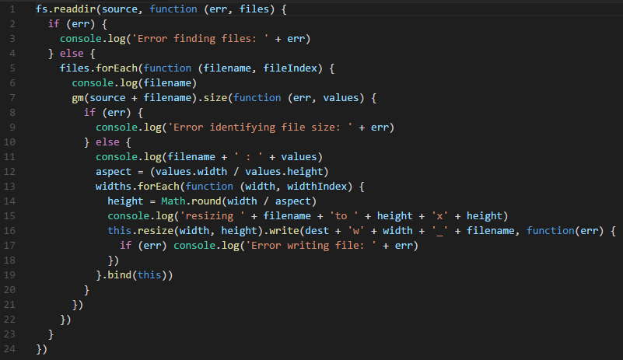
Complex callbacks

Slide 7
Practice
Research XMLHttpRequest
Investigate methods http://quotes.rest
Use XMLHttpRequest to call the URL
Display the quote in ‘h1’
Notes:
https://developer.mozilla.org/en-US/docs/Web/API/XMLHttpRequest
https://developer.mozilla.org/en/docs/Web/API/XMLHttpRequest/Using_XMLHttpRequest
No project is needed for this exercise – just code it in browser

Slide 8
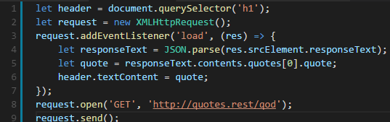
Solution

Slide 9
Promises
An object that represents a value
The value may be available now, or in the future, or never
You can get the value using .then() or .catch()

Slide 10
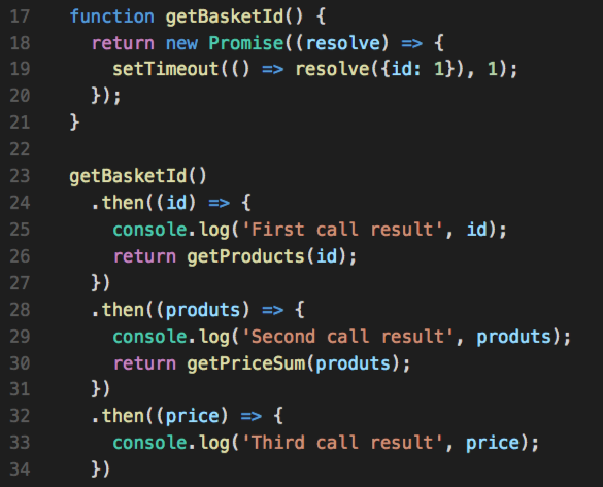
Promise chain

Slide 11
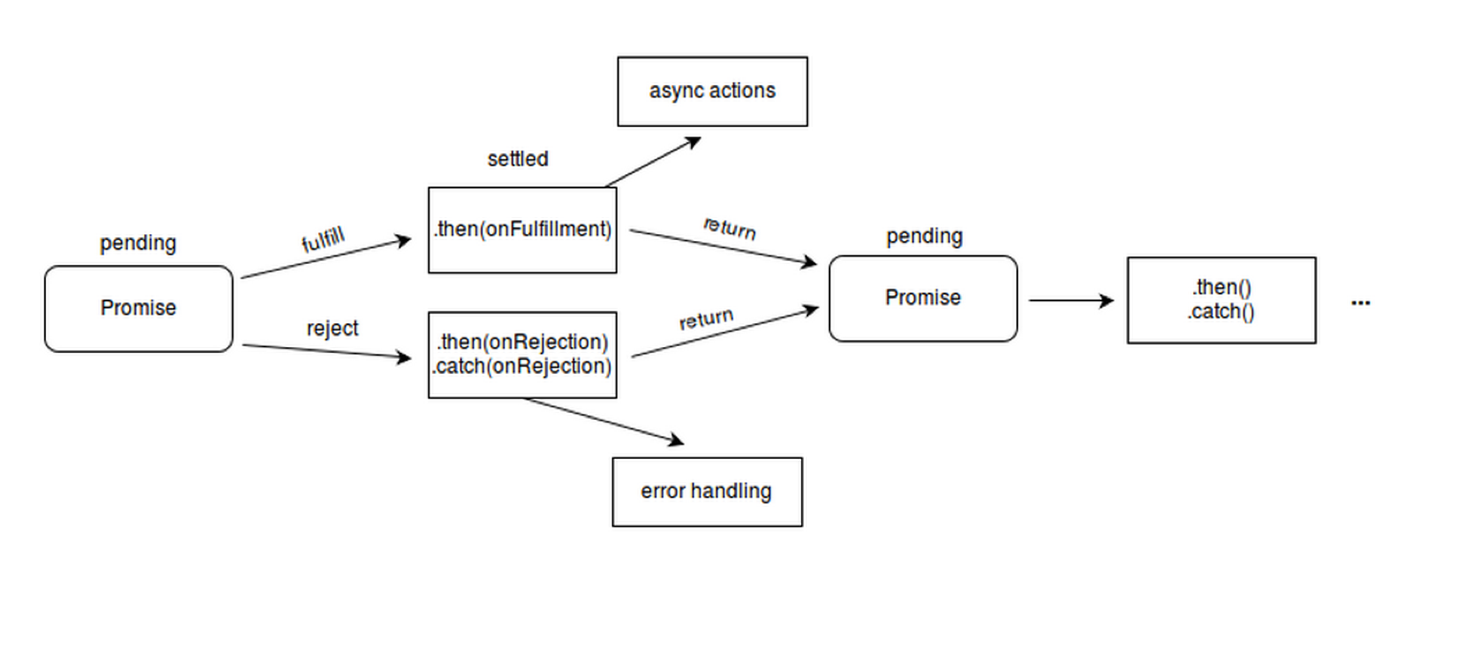
Promise state
pending: initial state, not fulfilled or rejected.
fulfilled: meaning that the operation completed successfully.
rejected: meaning that the operation failed.

Slide 12
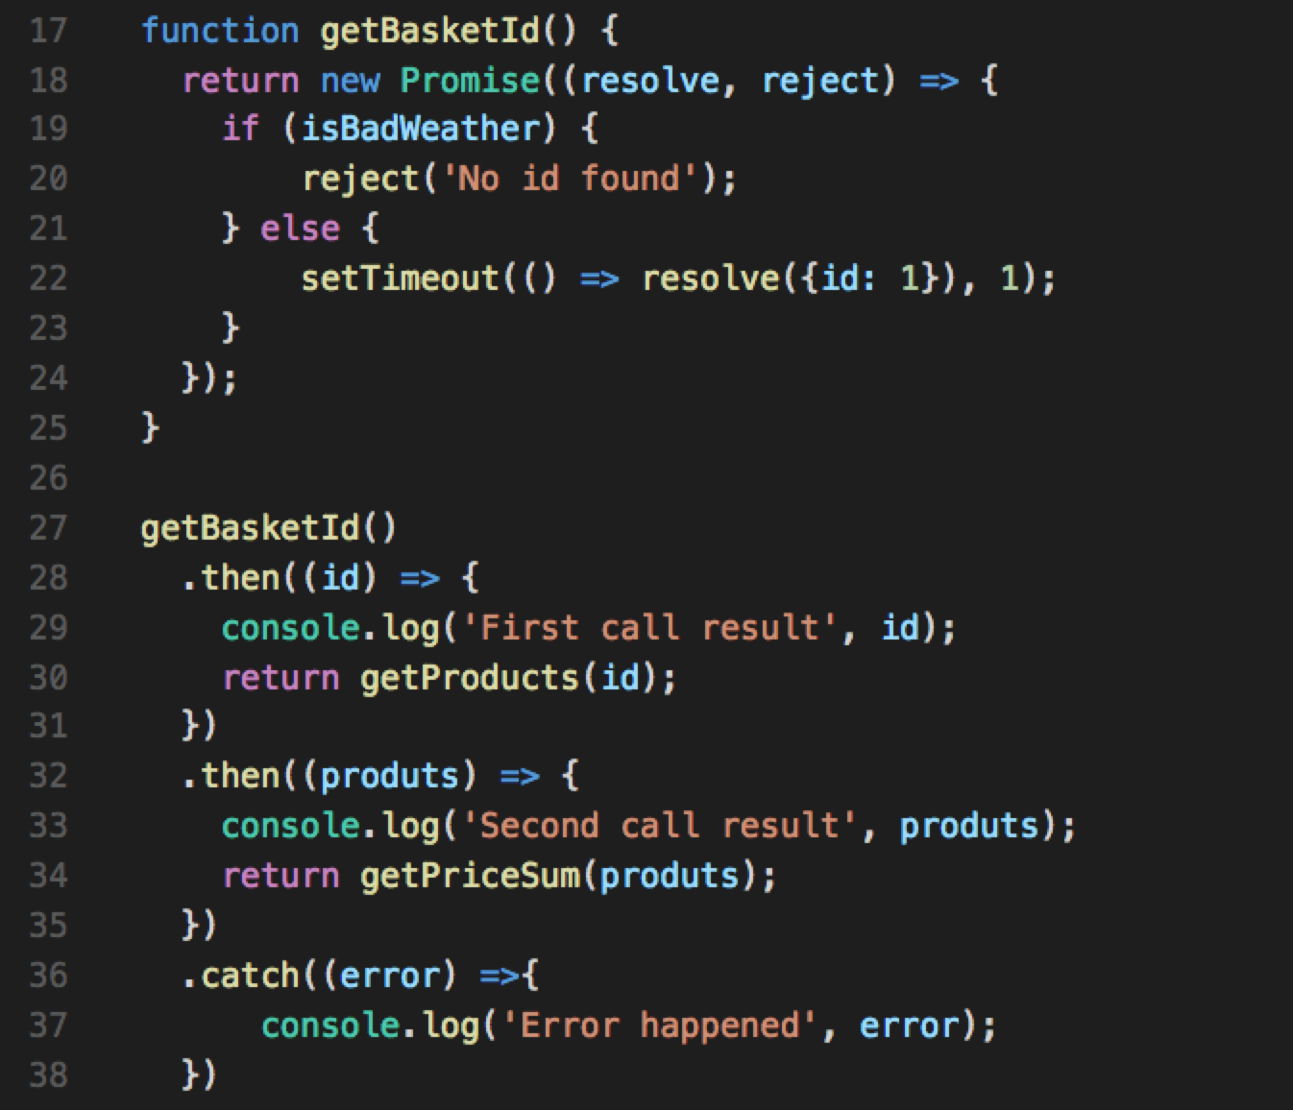
Promise error handling

Slide 13
Why promises?
Makes code look synchronous
Reduces nesting
Have a mechanism for error handling
Is a standard when dealing with asynchonicity

Slide 14
Practice
Research Fetch API
Investigate methods http://quotes.rest
Use Fetch API to call the URL
Display the quote in ‘h1’
Notes:
https://developer.mozilla.org/en/docs/Web/API/Fetch_API
https://developer.mozilla.org/en-US/docs/Web/API/Fetch_API/Using_Fetch
No project is needed for this exercise – just code it in browser

Slide 15
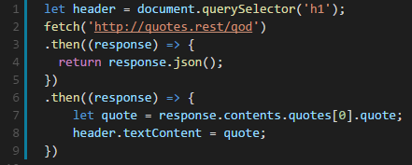
Solution
Notes:
https://developer.mozilla.org/en/docs/Web/API/Fetch_API
https://developer.mozilla.org/en-US/docs/Web/API/Fetch_API/Using_Fetch
No project is needed for this exercise – just code it in browser

Slide 16
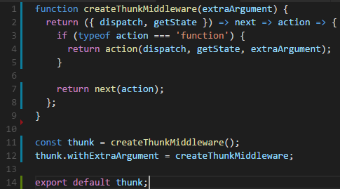
Redux Thunk
Middleware for dealing with actions
Enables returning a function instead of action
Injects dispatcher and getState into returned function

Slide 17
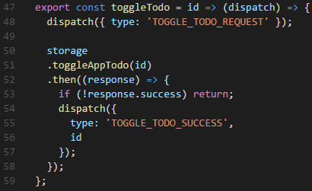
Redux Thunk

Slide 18
Why Redux Thunk?
Allows to deal with promises and call dispatcher when resolved
Thin and simple to use

Slide 19
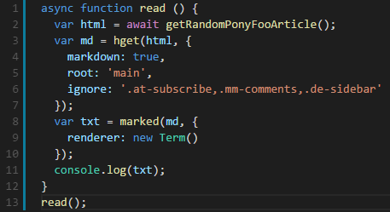
Async / await
Async / await
Synchronous flow of code
Not yet in ES
Notes:
https://ponyfoo.com/articles/understanding-javascript-async-await

Slide 20
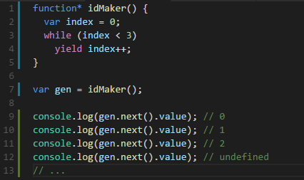
Generators*
Generators*
Let’s pause code with yield
Used for not only async

Slide 21
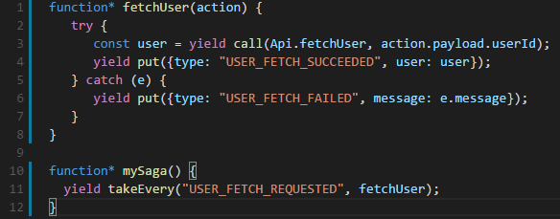
Redux Saga
More complex than Thunk
Sagas enpowers usage of generators* for asynch actions
Notes:
https://github.com/redux-saga/redux-saga

Slide 22
Questions?

Slide 23
Let’s code

Slide 24
Todo-App async
Our app should connect to the back-end to store data
How can we do that?
Where can we do that?

Slide 25
Todo App steps
Pull starter project from BitBucket
Init project
Investigate storageService
Add Redux Thunk
Rewrite Action Creators
Implement new actions
Notes:
Pull starter project from BitBucket
Init project
Investigate storageService
Add Redux Thunk
Rewrite Action Creators
Implement new actions

Slide 26
Thank You
www.devbridge.com
Sourcery Academy

